Slide 1

interview case
Gabriel Soliguetti gabrielsoliguetti@outlook.com

Slide 2
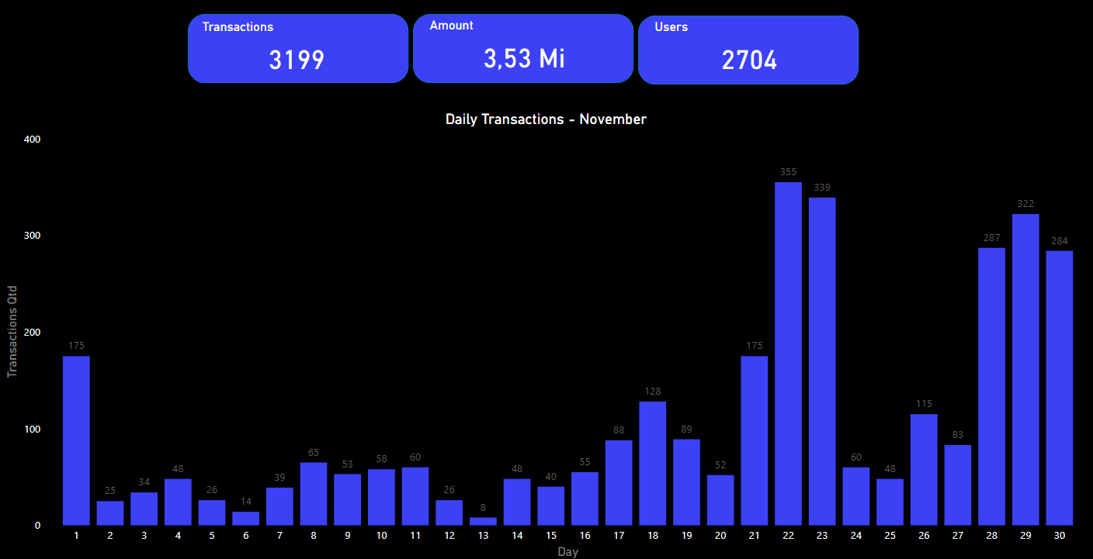
Transactions Volume
interview case

Slide 3
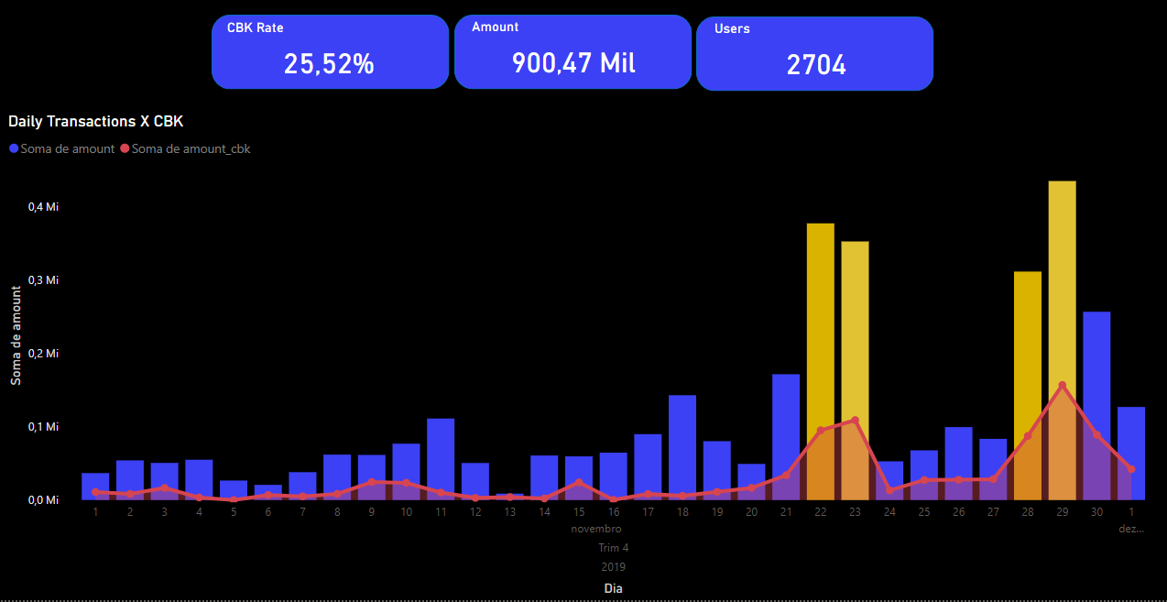
Chargebacks Volume
interview case
Increase of chargebacks highlighted in yellow.
High month CBK Rate (amount of CBK rate / amount of approved transactions considering the data sample

Slide 4
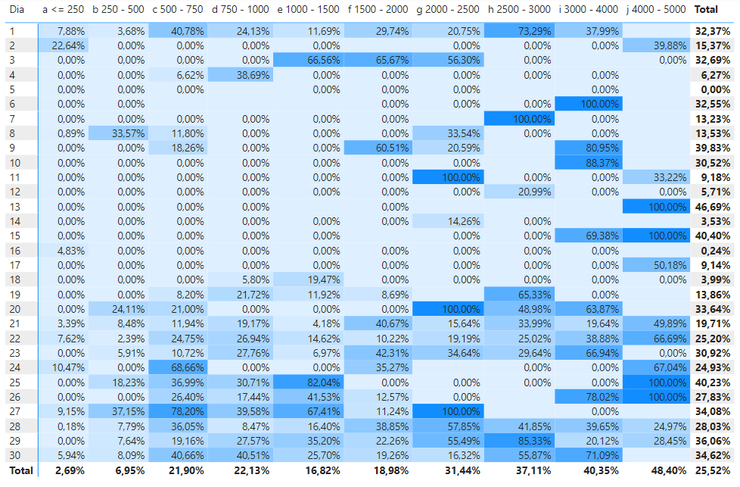
CBK x Price Range
interview case
Using hypothetical price ranges, we can see that the CBK rate raises when we look to more expensive purchases.
One way to analyze and avoid those types of CBKs is implanting rule mechanism for those price ranges.

Slide 5
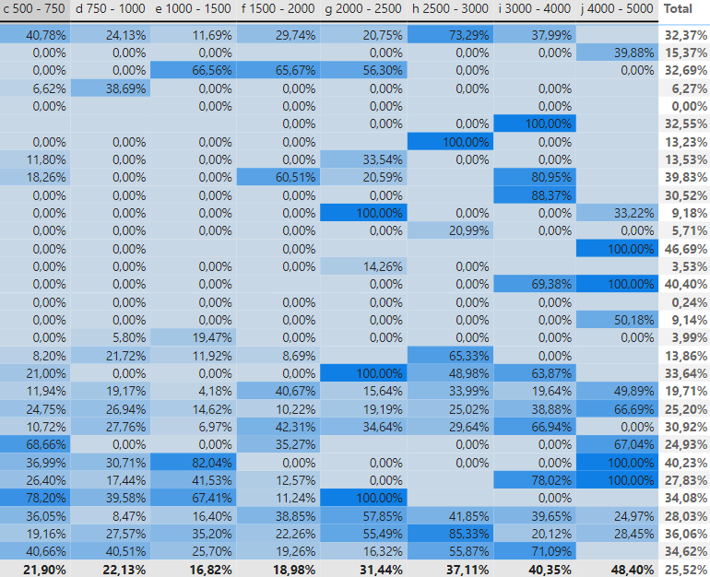
Rule per Price Range
interview case
Now that we understand that we have a lack of security of these price ranges that have highest levels of CBK rate, we can work in solution to avoid this in the future.
We can apply solutions such as 3DS to apply one more step of security, by making the user confirm the purchase through a SMS or Token Activation in a issuer’s app.
This can save more money from the merchant’s revenue, because if this generate a dispute, the issuers that will pay all the taxes involved in this process, including the CBK amount.

Slide 6
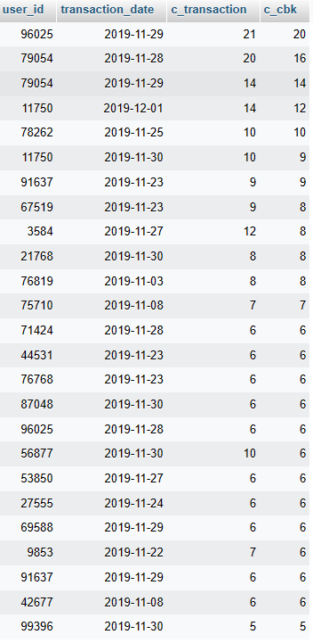
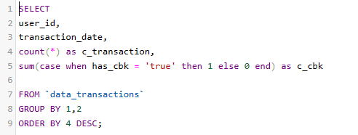
Detecting detractors
interview case
Beyond the previous matrix made in PowerBI, we also can use SQL to identify the friendly-fraud users that are attacking the merchants.
One way to avoid these users to make transactions in the future, is inserting their user_id, device_id and the card_number in a black list, so when they start a new transaction the system will deny it automatically.
In this case, I use the above code in MySQL to bring the main detractors of CBK rate.

Slide 7
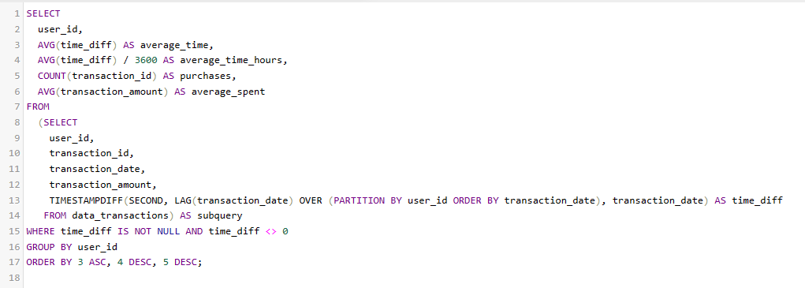
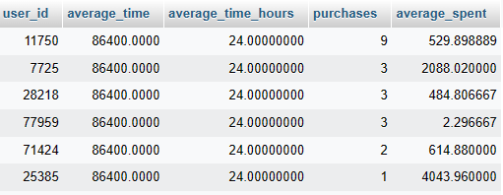
Velocity
interview case
We can also improve our security by analyzing quantity of purchases by hour and average spent.
Looking to the highlighted register we can observe that the users have a suspicious transactions per hour.
High amounts
High number of purchases
To improve our anti-fraud payment system, we can apply a limit of purchases per time.

Slide 8
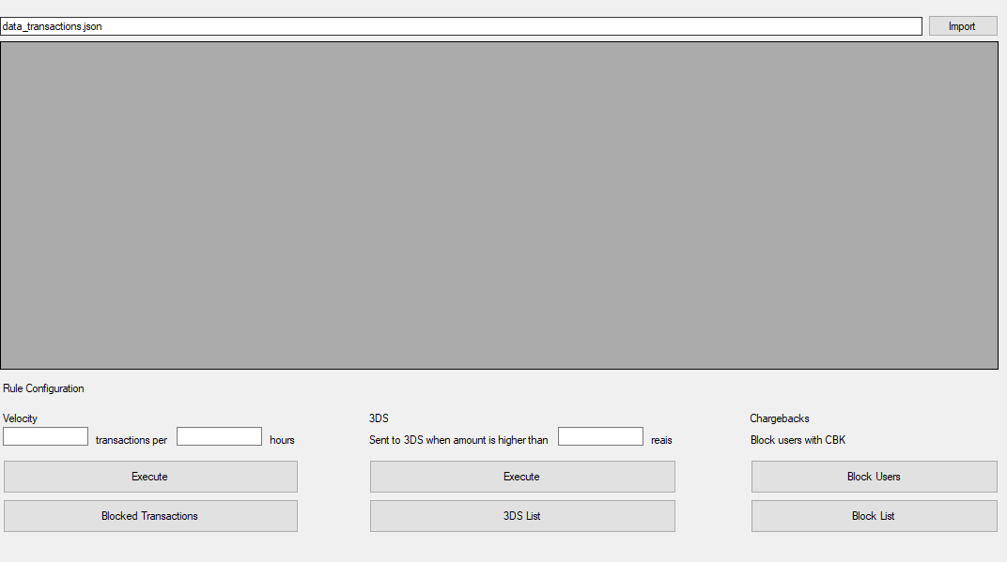
Rule Simulator Instructions
interview case
You can find the Rule Simulator in the github repository sent attached in e-mail.
start clicking here

Slide 9
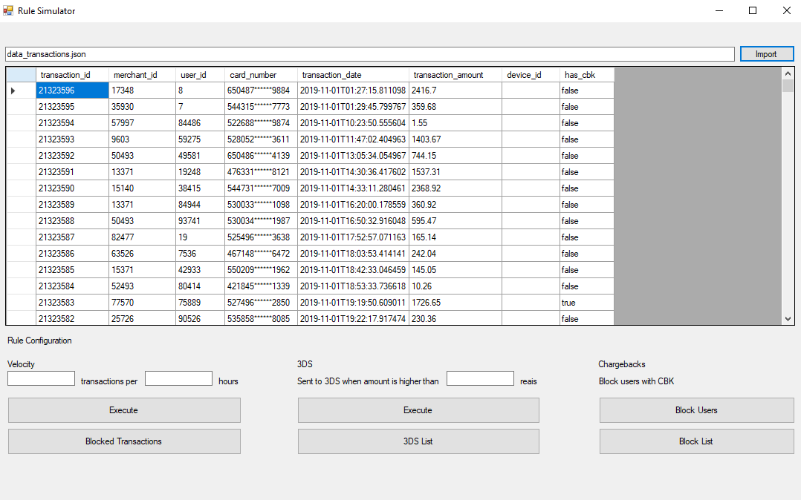
Rule Simulator Instructions
interview case
When show the data, you can set rules for velocity and 3DS and block users with CBK
after you define the number of transactions and hours, click in “Execute”

Slide 10
Rule Simulator Instructions
interview case
When show the data, you can set rules for velocity and 3DS and block users with CBK
when you click on “Block Transactions” you can see a list of blocked users

Slide 11
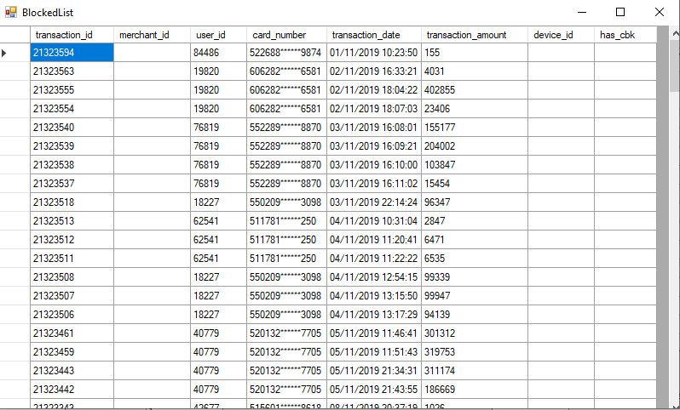
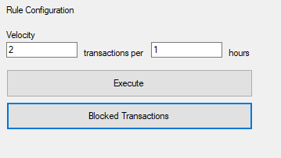
Rule Simulator Instructions
interview case
You can see a list of blocked users thats will help us to define which users are safe or not for transactions. In this example, I defined 2 transactions each 1 hours. Anything highers than these values will be sent to blocked transactions list and will be refused.

Slide 12
THANK YOU

